Slide 1

#RahoAmbitious
TechM Full Stack Software Development

Slide 2



Lecture On: HTML5 and Introduction to CSS
Instructor: Rushabh Shah

Slide 3
In the previous class, we discussed...
How forms are created in HTML
How the ‘Login’ and ‘Contact Us’ features are added on the Recipes Website

Slide 4

Today’s Agenda
Introduction to HTML5
New semantic elements introduced in HTML5
Introduction to CSS
How to add CSS and style our website
CSS height, width and unit

Slide 5

HTML5

Slide 6
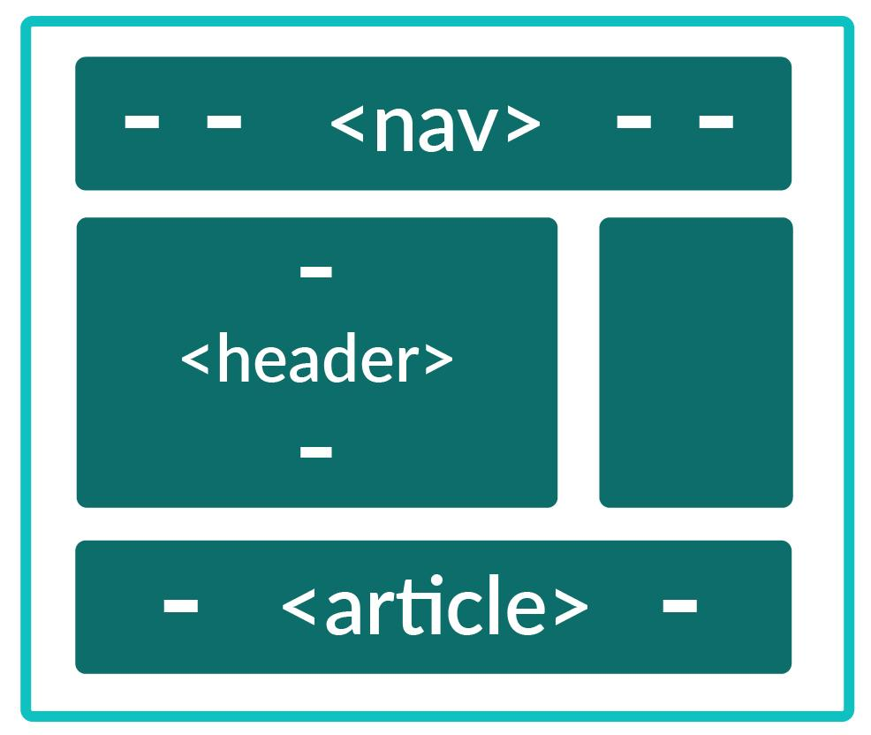





HTML5
What Is New in HTML5?
Canvas
Semantic Elements
This is a 2D drawing surface using JavaScript.
These are HTML elements that describe the meaning of the element to the browser and the user.
Persistent Local Storage
This is localised storage used to remove dependency on third-party plugins.
Geolocation
Using this, visitors can choose to share their location with the website requesting it.
Drag and Drop
This is used to drag and drop elements from one position to another.

Slide 7
HTML5
HTML5 Structure
<!DOCTYPE html> <html> <head> <meta charset=“utf-8”> <title>Introduction to HTML5</title> </head> <body> </body> </html>

Slide 8
HTML5
HTML5 Structure: Example
<!DOCTYPE html> <html> <head> <meta charset=“utf-8”> <title>Introduction to HTML5</title> </head> <body> <header role=“banner”> <h1>Introduction to HTML5</h1> </header> <article> <section> <p>One article can have multiple sections.</p> </section> </article> <footer>Created by upGrad.</footer> </body> </html>

Slide 9
HTML Forms
HTML5 Structure Explained
<!DOCTYPE html>
Information to the browser to declare it as an HTML5 document.
A charset stands for character encoding, which helps the computer interpret the input into real characters. UTF-8 uses 8-bit blocks to represent a character. UTF-8 covers all the characters, punctuations and symbols.
<meta charset=“utf-8”>
<header></header>
<header> is a semantic element used to represent the header of the document
<footer></footer>
<footerr> is a semantic element used to represent the footer of the document
<article></article>
<article> is a semantic element used to represent a self-contained content of a document.
<section></section>
<section> is a semantic element used to represent a section with headers in a document.
HTML5 tags similar to HTML tags are case-insensitive. Therefore, the tags <article> and <ARTICLE> are the same.

Slide 10



Poll 1 (10 Sec)
Which of the following is a DOCTYPE?
HTML tag
Document type
HTML element
None of the above
Practice in teams of 4 students
Industry expert mentoring to learn better
Get personalised feedback for improvements

Slide 11
Poll 1 (Answer)
Which of the following is a DOCTYPE?
HTML tag
Document type
HTML element
None of the above
Practice in teams of 4 students
Industry expert mentoring to learn better
Get personalised feedback for improvements

Slide 12
Poll 2 (15 Sec)
Which of the following is the correct syntax of a DOCTYPE in HTML5?
(Note: More than one option may be correct.)
<DOCTYPE html>
<doctype html>
<!DOCTYPE html>
<!doctype HTML>
Practice in teams of 4 students
Industry expert mentoring to learn better
Get personalised feedback for improvements

Slide 13
Poll 2 (Answer)
Which of the following is the correct syntax of a DOCTYPE in HTML5?
(Note: More than one option may be correct.)
<DOCTYPE html>
<doctype html>
<!DOCTYPE html>
<!doctype HTML>
Practice in teams of 4 students
Industry expert mentoring to learn better
Get personalised feedback for improvements

Slide 14
Poll 3 (15 Sec)
Will HTML5 work if you do not use <!DOCTYPE html>?
Yes
No
It will trigger the quirks mode or almost standards mode.
Unsure whether HTML5 would work or not
Practice in teams of 4 students
Industry expert mentoring to learn better
Get personalised feedback for improvements

Slide 15
Poll 3 (Answer)
Will HTML5 work if you do not put <!DOCTYPE html>?
Yes
No
It will go to the quirks mode or almost standards mode.
Unsure whether HTML5 would work or not
Practice in teams of 4 students
Industry expert mentoring to learn better
Get personalised feedback for improvements

Slide 16
HTML5
Semantic Elements
<header>
<!DOCTYPE html> <html> <head> <meta charset=“utf-8”> <title>Introduction to HTML5</title> </head> <body> <header> <h1>Introduction to HTML5</h1> <p>Posted on Monday, 1 July 20202 by Prachi </p> </header> </body> </html>
This tag represents the header section of a web page.
It is normally added at the top of the <body> tag.
It may contain some heading elements but also a logo, a search form, an author name, and other elements, which form introductory or navigational aids.

Slide 17
HTML5
Semantic Elements
<footer>
<!DOCTYPE html> <html> <head> <meta charset=“utf-8”> <title>Introduction to HTML5</title> </head> <body> <footer> <p>&copy; Developed by upGrad.</p> <a href=“https://www.upgrad.com/”> Connect with us on Facebook </a> </footer> </body> </html>
This tag represents the footer or the end of a web page.
It is normally added at the end of the <body> tag.
It generally has the links and addresses of social media accounts required for contacting the owners of these social media accounts, author details, copyright details.

Slide 18
HTML5
Semantic Elements
<nav>
<!DOCTYPE html> <html> <head> <meta charset=“utf-8”> <title>Introduction to HTML5</title> </head> <body> <nav> <ul> <li><a href=“./index.html”>Home</a></li> <li><a href=“./about.html”>About Us</a></li> <li><a href=“./contact.html”>Contact</a></li> </ul> </nav> </body> </html>
This tag represents the navigation bar that is generally found at the top of a website.
Common examples of navigation sections are menus, tables of contents, and indexes.

Slide 19
HTML5
Semantic Elements
<!DOCTYPE html> <html> <body onload="draw();"> <canvas id="canvas" width="130" height="100"> </canvas> <script> function draw() { var canvas = document.getElementById('canvas'); if (canvas.getContext) { var ctx = canvas.getContext('2d'); var rectangle = new Path2D(); rectangle.rect(10, 10, 50, 50); var circle = new Path2D(); circle.moveTo(125, 35); circle.arc(100, 35, 25, 0, 2 * Math.PI); ctx.stroke(rectangle); ctx.fill(circle); } } </script> </body> </html>
<canvas>
The <canvas> tag is an empty space for drawing an element using JavaScript.

Slide 20
HTML5
Semantic Elements
<svg>
<!DOCTYPE html> <html> <head> <meta charset=“utf-8”> <title>Introduction to HTML5</title> </head> <body> <svg width=“100” height=“100”> <circle cx=“5” cy=“5” r=“4” fill=“red” /> </svg> </body> </html>
The <svg> tag is a container for Scalar Vector Graphics (SVG).
Inside <svg>, you can create elements/shapes using <circle>, <rect>, <polygon>, etc.

Slide 21
HTML5
Semantic Elements
<section>
<!DOCTYPE html> <html> <head> <meta charset=“utf-8”> <title>Introduction to HTML5</title> </head> <body> <section> <h1>World War 2</h1> <p>The World War 2 began in 1939 when Germany declared war on Poland, followed by England and France declaring on Germany.</p> </section> </body> </html>
In simple words, the <section> tag defines a section of a web page.
Typically, a section always has a header that defines the heading of the content and the content itself.
Headings are generally defined <h1>–<h6> tags, and the content of the section tag can be anything from text to images, videos or graphics.

Slide 22
HTML5
Semantic Elements
<aside>
<!DOCTYPE html> <html> <head> <meta charset=“utf-8”> <title>Introduction to HTML5</title> </head> <body> <p>World War 2 started in 1939 after England and France declared war on Germany.</p> <aside> <h4>Related Articles</h1> <p>Adolf Hitler</p> <p>Atomic Bombing of Japan</p> </aside> </body> </html>
As the name suggests, this tag basically refers to the section of a website that is not directly related to the main content.
Think of <aside> as a sidebar or the ‘Related Articles’ section of a website.

Slide 23
HTML5
Semantic Elements
<!DOCTYPE html> <html> <head> <meta charset=“utf-8”> <title>Introduction to HTML5</title> </head> <body> <audio controls autoplay> <source src="myAudio.mp3" type="audio/mpeg"> <source src="myAudio.ogg" type="audio/ogg"> <p> Your browser doesn't support HTML5 audio. </p> </audio> </body> </html>
<audio>
It is used to embed audio in our HTML document.
A single HTML document may consist one or more audios.
It has multiple attributes such as:
controls
autoplay
muted
loop
duration

Slide 24
HTML5
Semantic Elements
<video>
<!DOCTYPE html> <html> <head> <meta charset=“utf-8”> <title>Introduction to HTML5</title> </head> <body> <video controls> <source src="myVideo.mp4" type="video/mp4"> <source src="myVideo.webm" type="video/webm"> <p> Your browser doesn't support HTML5 video. </p> </video> </body> </html>
The <video> tag is used to embed a media player into the document.
You can use <video> tag for the audio content as well, but using <audio> element is suggested because it provides a more appropriate user experience.
It has multiple attributes such as:
controls
width
autoplay
muted
loop
duration

Slide 25
Poll 4 (15 Sec)
How are tags migrated from HTML4 to HTML5?
<div><!-- footer --></div> to <footer>
<div><!-- header--></div> to <header>
<div><!-- menu></div> to <nav>
All of the above
Practice in teams of 4 students
Industry expert mentoring to learn better
Get personalised feedback for improvements

Slide 26
Poll 4 (Answer)
How are tags migrated from HTML4 to HTML5?
<div><!-- footer --></div> to <footer>
<div><!-- header--></div> to <header>
<div><!-- menu></div> to <nav>
All of the above
Practice in teams of 4 students
Industry expert mentoring to learn better
Get personalised feedback for improvements

Slide 27
Poll 5 (15 Sec)
For what purpose is the canvas element used in HTML5?
To declare HTML documents
To draw graphics on a web page
To make sections on a web page
None of the above
Practice in teams of 4 students
Industry expert mentoring to learn better
Get personalised feedback for improvements

Slide 28
Poll 5 (Answer)
For what purpose is the canvas element used in HTML5?
To declare HTML documents
To draw graphics on the web page
To make sections on the web page
None of the above
Practice in teams of 4 students
Industry expert mentoring to learn better
Get personalised feedback for improvements

Slide 29
Poll 6 (15 Sec)
What does SVG stand for?
Scaled Vector Graphics
Scalable Vector Graphics
Searched Vector Graphics
All of the above
Practice in teams of 4 students
Industry expert mentoring to learn better
Get personalised feedback for improvements

Slide 30
Poll 6 (Answer)
What does SVG stand for?
Scaled Vector Graphics
Scalable Vector Graphics
Searched Vector Graphics
All of the above
Practice in teams of 4 students
Industry expert mentoring to learn better
Get personalised feedback for improvements

Slide 31

Project Work
(We will add HTML5 elements to our project wherever required.)
You can refer to the solution here.

Slide 32
Doubts Clearance (5 min)

Slide 33

Introduction to CSS

Slide 34
Introduction to CSS
CSS stands for Cascading Style Sheets.
It makes an HTML website presentable.
It adds style to various HTML elements.
It helps you to define how the elements should look, where they should be placed and whether they should be displayed or not.
It also helps you to define how elements should look on different devices.

Slide 35


Introduction to CSS
class vs id
class
id
A group of people exhibiting the same properties
An individual with his/her own identity

Slide 36
Introduction to CSS
Syntax of CSS
h1 { color: green; font-size: 14px; }
Declaration
Declaration
Selector
Property
Value
A selector can be an element itself such as p, h1 or the class or the id.
A property signifies the property of an element, such as the color of a text element.
A value signifies the value that should be assigned to a property, such as red for the color property.

Slide 37
Introduction to CSS
Comment CSS Code
h1 { color: green; /*font-size: 14px;*/ } /* h2 { color: red; text-align: center; } */
Single-line comment
Multi-line comment
A CSS code can be commented out by adding /* and */ to the code.

Slide 38
Introduction to CSS
CSS Selectors
<p class=“paragraph”>This is a paragraph.</p> <h1 id=“header1”>This is a header.</h1> <span>This is a span.</span>
span { color: green; } /*Element selector*/ .paragraph { color: green; } /* Class selector */ #header1 { color: green; } /* ID Selector */ * { color: green; } /* Universal Selector */
Element selectors only require the element name.
Class selectors require ‘.’ before the class name given to an element.
ID selectors require ‘#’ before the ID name given to an element.
Universal selector require ‘*’. It signifies all the elements in a given file.

Slide 39
Poll 7 (15 Sec)
What does CSS stand for?
Creative Styling Sheets
Colourful Style Sheets
Cascading Style Sheets
Class Style Sheet
Practice in teams of 4 students
Industry expert mentoring to learn better
Get personalised feedback for improvements

Slide 40
Poll 7 (Answer)
What does CSS stand for?
Creative Styling Sheets
Colourful Style Sheets
Cascading Style Sheets
Class Style Sheet
Practice in teams of 4 students
Industry expert mentoring to learn better
Get personalised feedback for improvements

Slide 41
Poll 8 (15 Sec)
Which of the following is true about the priority of a CSS selector?
ID > Class > Element
Element > ID > Class
Element > Class > ID
None of the above
Practice in teams of 4 students
Industry expert mentoring to learn better
Get personalised feedback for improvements

Slide 42
Poll 8 (Answer)
Which of the following is true about the priority of CSS selector?
ID > Class > Element
Element > ID > Class
Element > Class > ID
None of the above
Practice in teams of 4 students
Industry expert mentoring to learn better
Get personalised feedback for improvements

Slide 43
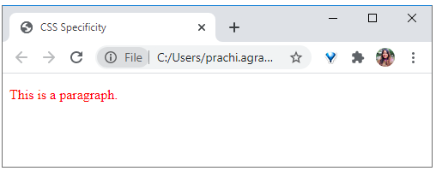
Introduction to CSS
Priority CSS Selectors
<p id=”para” class=“paragraph”> This is a paragraph. </p>
p { color: blue; } /*Element selector*/ .paragraph { color: green; } /* Class selector */ #para { color: red; } /* ID Selector */

Slide 44
Poll 9 (15 Sec)
What will be the output of the following CSS code?
Red
Green
No colour
p { color: red } p { color: green }
Practice in teams of 4 students
Industry expert mentoring to learn better
Get personalised feedback for improvements

Slide 45
Poll 9 (Answer)
What will be the output of the following?
Red
Green
No colour
**You can read more about specificity here.
p { color: red } p { color: green }
Practice in teams of 4 students
Industry expert mentoring to learn better
Get personalised feedback for improvements

Slide 46
CSS: How to Use
Introduction to CSS
{ }

Slide 47
Introduction to CSS
Inline vs Internal vs External
<!DOCTYPE html> <html> <head> <meta charset=“utf-8”> <title>Inline CSS</title> </head> <body> <span style=“color: red”> This is a span. </span> </body> </html>
<!DOCTYPE html> <html> <head> <meta charset=“utf-8”> <title>Internal CSS</title> <style> .text1 { color: red; } </style> </head> <body> <span class=“text1”>This is a span.</span> </body> </html>
Inline CSS
Internal CSS

Slide 48
Introduction to CSS
Inline vs Internal vs External
<!DOCTYPE html> <html> <head> <meta charset=“utf-8”> <title>External CSS</title> <link href=“index.css” rel=“stylesheet” /> </head> <body> <span class=“text1”>This is a span.</span> </body> </html>
.text1 { color: red; }
index.html
index.css
External CSS

Slide 49
Introduction to CSS
Inline vs Internal vs External
Inline stylesheet: This is a CSS that is directly applied to an element inside HTML code.
Internal stylesheet: This is a CSS that is applied inside a file but not inside an element. It is generally added inside the <style> tag, which is contained within the <head> tag.
External stylesheet: This is a CSS that is applied from an external file. This external file is referred to inside the HTML code using the <link> tag.
The following is the order of priority: Inline > Internal > External.

Slide 50
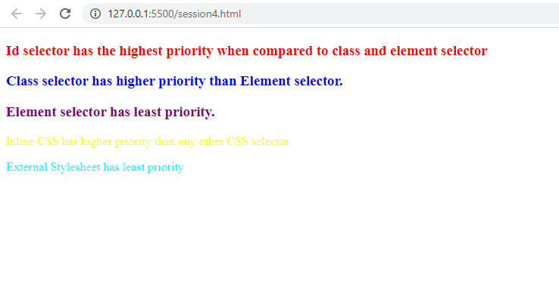
Hands-On Exercise (3 min)
Write a program for the given stub code such that the output is as shown in the adjoining screenshot.
The stub code is provided here.
The solution is provided here.

Slide 51
Poll 10 (15 Sec)
Which of the following is the correct order of inline, external and internal CSS?
Inline > External > Internal
Inline > Internal > External
External > Internal > Inline
Internal > External > Inline
Practice in teams of 4 students
Industry expert mentoring to learn better
Get personalised feedback for improvements

Slide 52
Poll 10 (Answer)
Which of the following is the correct order of inline, external and internal CSS?
Inline > External > Internal
Inline > Internal > External
External > Internal > Inline
Internal > External > Inline
Practice in teams of 4 students
Industry expert mentoring to learn better
Get personalised feedback for improvements

Slide 53
Poll 11 (15 Sec)
Where do we need to declare the reference to an external style sheet in our HTML document?
Before the <head> section
In the <head> section
In the <body> section
After the <body> section
Practice in teams of 4 students
Industry expert mentoring to learn better
Get personalised feedback for improvements

Slide 54
Poll 11 (Answer)
Where do we need to declare the reference to an external style sheet in our HTML document?
Before the <head> section
In the <head> section
In the <body> section
After the <body> section
Practice in teams of 4 students
Industry expert mentoring to learn better
Get personalised feedback for improvements

Slide 55
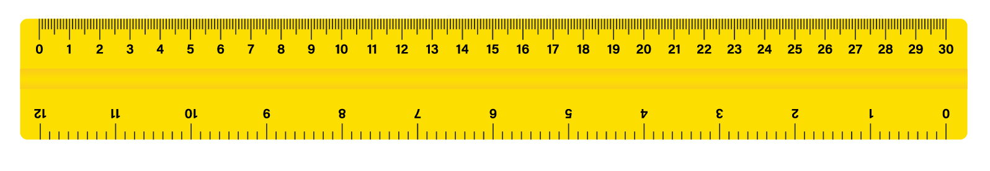
CSS: Height, Width and Unit
Introduction to CSS

Slide 56
Introduction to CSS
CSS Units: Absolute vs Relative
Absolute Units
body
body
body
<div>
<div>
Absolute units do not change size with respect to the container', i.e., their size are fixed.
The examples of absolute units are px.

Slide 57
Introduction to CSS
CSS Units: px
body { font-size: 16px; } section { font-size: 14px; } div { font-size: 10px; }
div
section
body
The unit px will maintain the exact size given to it.

Slide 58
Introduction to CSS
CSS Units: Absolute vs Relative
Relative Units
body
body
body
body
<div>
<div>
Relative units change size along with their container, i.e., their size is not fixed.
An example of a relative unit is em.

Slide 59
Introduction to CSS
CSS Units: em
body { font-size: 16px; } section { font-size: 14px; } div { font-size: 1em; /* 1em = 14px */ }
div
section
body
The unit em will take the size of the parent element.
Therefore, 1em = 14px (size of parent ‘section’) 2em = 28px, etc.

Slide 60
Introduction to CSS
CSS Units: rem
body { font-size: 16px; } section { font-size: 14px; } div { font-size: 1rem; /* 1rem = 16px */ }
div
section
body
The unit rem will take the size of the root element, which is normally the body.
Therefore, in the example given above, 1rem = 16px, 2em = 32px, etc.

Slide 61
Introduction to CSS
CSS Units: vw and vh
.div-1
.div-2
.div-1 { height: 1vh; } .div-2 { height: 100vh; }
body
The unit vw stands for the viewport width, and vh stands for the viewport height.
Therefore, 1vh stands for 1% of the viewport height (window height), and 100vh stands for 100% of the viewport height (window height). The same applies to vw.

Slide 62
Introduction to CSS
CSS Units: vmin, vmax and ch
The unit vmin stands for the minimum of the viewport. It denotes the minimum between the viewport height and the viewport width.
1vmin is equal to 1vw or 1vh, whichever value is smaller.
The unit vmax stands for the maximum of the viewport. It denotes the maximum between the viewport height and the viewport width.
1vmax is equal to 1vw or 1vh, whichever value is higher.
1ch sets the font size relative to the width of the character ‘0’.

Slide 63
Introduction to CSS
CSS Height and Width
Width
<div>
Height

Slide 64

Introduction to CSS
CSS Heights and Widths: min
Question: A container has 10 oranges. If you are allowed to take a minimum of three oranges from this container, what is the least number of oranges that you can take?
Question: What is the maximum number of oranges that you can take?
Question: Can you also take more than three and less than 10 oranges?
YES
Since the minimum number of oranges you are allowed to take is three, you can also take four, five, six oranges or up to a maximum of 10 oranges.

Slide 65
Introduction to CSS
CSS Heights and Widths: min
div { min-height: 200px; }
When the minimum height is specified, it means that a height that is lower than the specified value cannot be taken, but there is no limit on the height taken above the specified value.
In the example given above, the div can take any height higher than or equal to 200px (such as 300px, 450px and 1,000px), but it will not be allowed to take any height lower than 200px.
The same applies to minimum width.

Slide 66
Introduction to CSS
CSS Heights and Widths: max
Question: A container has 10 oranges. If you are allowed to take a maximum of five oranges from this container, what is the least number of oranges you can take?
Question: What is the maximum number of oranges you can take?
Question: Can you also take more than 0 and less than five oranges?
YES
Since the maximum number of oranges you are allowed to take is five, you can either take no oranges or take only one, two or up to five oranges.
0

Slide 67
Introduction to CSS
CSS Heights and Widths: max
div { max-height: 200px; }
When the maximum height is specified, it means that a height higher than the specified value cannot be taken, but there is no limit on the height taken lower than the specified value.
In the example given above, the div can take any height lower than or equal to 200px (such as 150px, 100px and 5px), but it will not be allowed to take height higher than 200px.
The same applies form maximum width.

Slide 68
Introduction to CSS
CSS Heights and Widths: max and min
div { min-height: 200px; max-height: 1000px; }
When both min and max are specified, they define a boundary between the two values.
In the example given above, the div has a minimum height of 200px, and therefore, it cannot take any height value lower than 200px.
Similarly, it has a maximum height of 1,000px, and therefore, it cannot take any value higher than 1,000px.
Therefore, our div cannot have a height lower than 200px or higher than 1,000px.

Slide 69
Doubt Clearance (5 min)

Slide 70
Project Work
(Let’s start adding CSS to our project.)
You can refer to the solution here.

Slide 71
Poll 12 (15 Sec)
Which of the following units is used to denote the absolute height and width of an element?
(Note: Multiple options may be correct.)
px
em
%
rem
Practice in teams of 4 students
Industry expert mentoring to learn better
Get personalised feedback for improvements

Slide 72
Poll 12 (Answer)
Which of the following units is used to denote the absolute height and width of an element?
(Note: Multiple options may be correct.)
px
em
%
rem
Practice in teams of 4 students
Industry expert mentoring to learn better
Get personalised feedback for improvements

Slide 73

Hands-On Exercise (3 min)
Write a program which has a main-container of 100% height and 100% width.
Inside the main container, you should have a video Butterfly.mp4 given inside media folder. The video should play as soon as the page loads, should provide with the possibility to play/pause, should continue playing continuously, and should not have any sound. The video should have maximum absolute height 300 and maximum absolute width 700.
Below video you should include the audio vibes.mp3 given inside media folder. The audio should not play automatically when the page loads and it should provide you with the possibility to play/pause the audio and it should play continuously after playing it until you manually pause it. The audio should have absolute width 540.
Note: Watch the video for better understanding by clicking
on the black box.
The stub code is provided here.
The solution is provided here.

Slide 74
Doubt Clearance (5 min)

Slide 75
Key Takeaways:
HTML5 has a host of new features including semantic elements, drag and drop, geolocation, local storage, and new attributes in form.
CSS adds styling to HTML and makes HTML elements presentable.
You can access elements in CSS using the tag name or the class (‘.’), id (‘#’) or universal (‘*’) selectors.
CSS styles can be added in-line, internally in the <style> tag and via an external style sheet. These are arranged in the order of priority as follows: inline > internal > external.
For an element, min-* is the minimum value, and max-* is the maximum value.
Absolute units such as px do not change size with respect to the containers, and relative units such as em or rem change size with respect to the containers.

Slide 76
The following tasks are to be completed after today’s session:
MCQs
Coding Questions
Project: Checkpoint 4

Slide 77
In the next class, we will discuss...
CSS colours
CSS backgrounds
CSS borders, margins and paddings
CSS box model
CSS outline

Slide 78
#RahoAmbitious
Thank you!

